Slide 1
TELECOM CHURN ANALYSIS
TEAM MEMBERS- GROUP 1
Nithin M
Subin S Nair
Shubhangi Shivaji Arote
Manish Ashok Patil
Subham kar
Sneha Sanjay Jadhav
Purva Kaiwart

Slide 2
CONTENTS:- 1. Business Problem statement. 2. Objective 3. Detailed summary of data 4. Exploratory Data Analysis 5. Recommendation 6. Conclusion for EDA 7. Feature engineering, model building & Deployment part.

Slide 3
BUSINESS PROBLEM STATEMENT
Customer churn is a big problem in telecom industry.
Churn prediction is nothing but detecting customers who are likely to cancel their subscription to a service.
Churn is a problem to the telecom industry since it is more expensive to acquire a new customer than to keep your existing one from leaving.

Slide 4
OBJECTIVE
Maximize: Company’s profit by retaining customer.
Minimize: Customer churn by identifying the key cause of the problem.
Business Constraint:
Provide offers and discount and improve the service quality without
compromising with profit.
This is a classification project since the variable to be predicted is binary (churn or not churn). The objective here is to predict churn probability, conditioned on the customer features.

Slide 5
DETAIL SUMMARY OF DATA
Telecom Data Set
(Data types)
Integer
Object
Float
Total Integer records = 7 nos
Total object records = 5 nos
Total float records = 8 nos
Important Notes:-
1. Here the decision variable is the ‘churn’ column – ‘y’
2. Rest all the others lies In the feature space ‘X’

Slide 6
DETAIL SUMMARY OF DATA (GETTING A BIG PICTURE OF DATA SET)
First 5 data sets
Last 5 data sets
Data Shape – (5000,21)
Checking for Data Types – For some of the data sets we have changed their data types.
Checking for null values – we had some null values in day charge & eve min column we had filled them up with mean values (since they were numeric columns)
Checking for duplicated values – 0
Checking for unique values

Slide 7
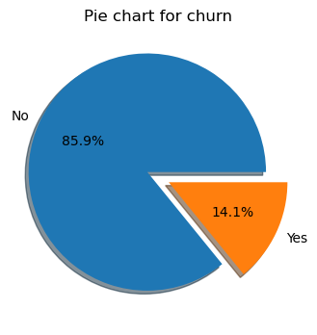
EXPLORATORY DATA ANALYSIS (Analyzing dependent variable ‘Churn)
Study with the Pie Chart
No of total customers in data set = 5000 nos
No of total customers churn = 707 nos
No of un-churn customers = 4293 nos
The % wise details is shown as given in the chart.

Slide 8
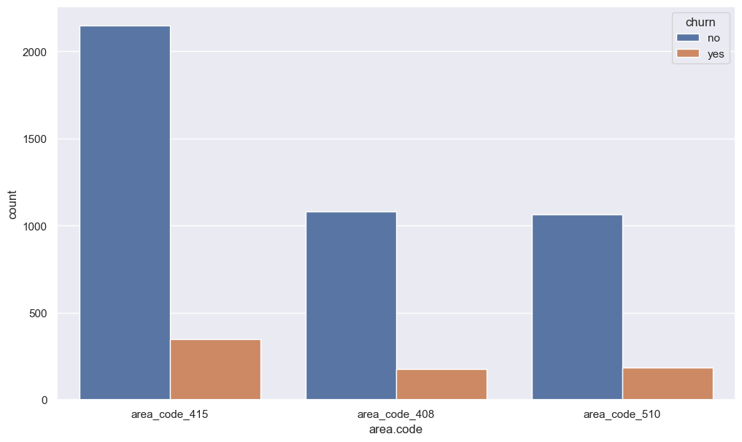
EXPLORATORY DATA ANALYSIS
Analyzing the area code column
In the above data, we notice that there is only 3 unique value are there i.e415,408,510 and the churn rate of these area codes are almost same.
we don't think there is any kind of relation present between the "area code" and"churn" due to which the customer leaves the operator.

Slide 9
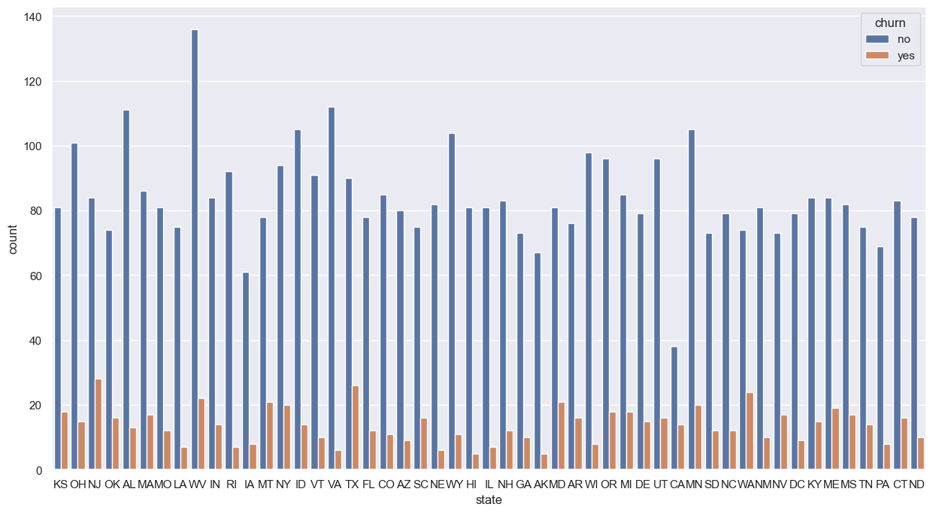
EXPLORATORY DATA ANALYSIS
Analyzing the state column

Slide 10
EXPLORATORY DATA ANALYSIS
After analyzing it is seen that, there are total 51 unique states.
Out of these 51 unique states, 10 states have higher churn rate of 21%
The reason for this churn rate may be due to low coverage area of the cellular network.
The following are the top 10 states which have this problem.
Sr. No | State Name | % Churn > 21%
1 | CA | 26.9
2 | NJ | 25.00
3 | WA | 24.40
4 | TX | 22.40
5 | MT | 21.21
6 | MD | 20.58
7 | NV | 18.88
8 | ME | 18.44
9 | KS | 18.18
10 | OK | 17.77

Slide 11
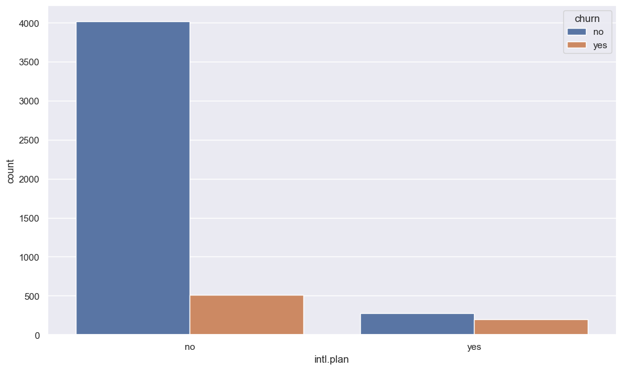
EXPLORATORY DATA ANALYSIS
Analyzing the international plan column

Slide 12
EXPLORATORY DATA ANALYSIS
Total customers without international plan are 4527
Total customers with international plan are 473
Hence we observe that, people who have taken international plan have more churn rate of 42%
So basically the people who bought International plans are churning in big numbers. Probably because of connectivity issues or high call charge.
Sr. No | Plan Type | Not Churn | Churn | % Churn
1 | No International Plan | 4019 | 508 | 11.22%
2 | With International Plan | 274 | 199 | 42.07%

Slide 13
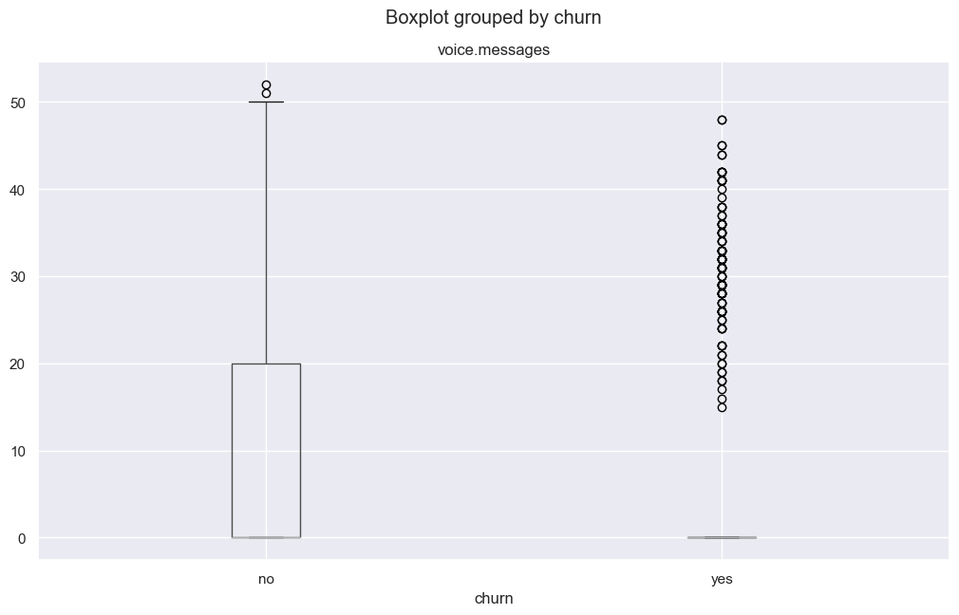
EXPLORATORY DATA ANALYSIS
Analyzing the voice message column
After analyzing the above voice mail feature data we get an insight that when there are more than 20 voice-mail messages then there is a churn For that, we need to improve the voice mail quality.

Slide 14
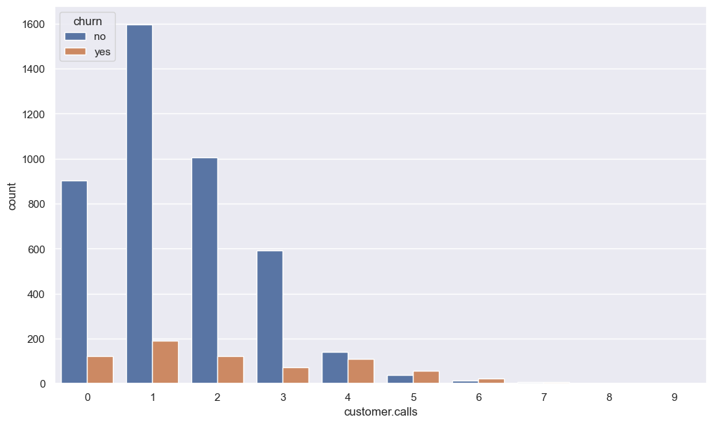
EXPLORATORY DATA ANALYSIS
Analyzing the customer calls column

Slide 15
EXPLORATORY DATA ANALYSIS
The above data shows that customer car services are not good at attending the queries of the customer, & also customer who had called more than 5 times have % churn of 60%. Hence they need to improve their services
Sr. No | No of Customer calls | Not Churn | Churn | % Churn
1 | 0 | 902 | 121 | 11.8
2 | 1 | 1596 | 190 | 10.63
3 | 2 | 1005 | 122 | 10.82
4 | 3 | 592 | 73 | 10.97
5 | 4 | 141 | 111 | 44.04
6 | 5 | 38 | 58 | 60.41
7 | 6 | 12 | 22 | 64.70
8 | 7 | 6 | 7 | 53.84
9 | 8 | 1 | 1 | 50.00
10 | 9 | 0 | 2 | 100.00

Slide 16
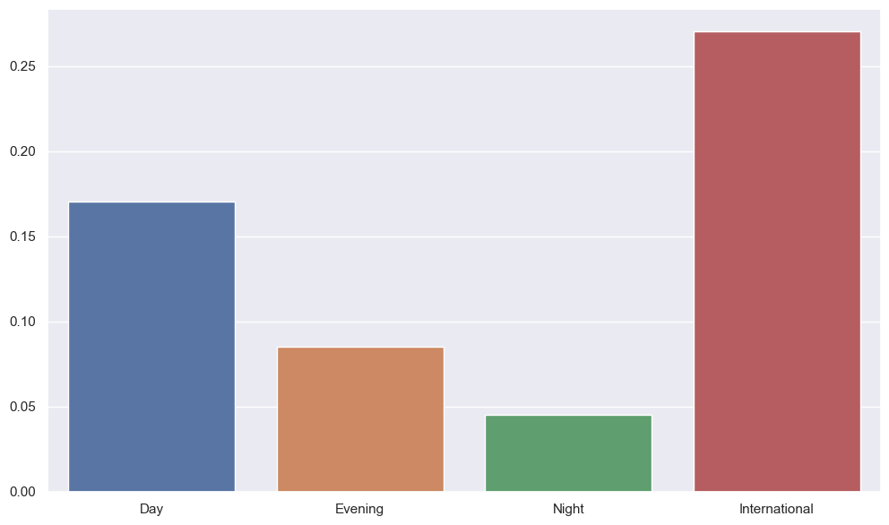
EXPLORATORY DATA ANALYSIS
Analyzing other remaining columns
After analyzing,
Day charge vs Day Mins
Eve charge vs eve Mins
Night Charge vs Night Mins
Intl charges vs Intl Mins
We come to the conclusion that,
The above dataset we have noticed that total day/night/eve minutes/call/charges do not put any kind of cause for churn rate.
But international call charges are high as compare to others it's an obvious thing but that may be a cause for international plan customers to churn out.

Slide 17
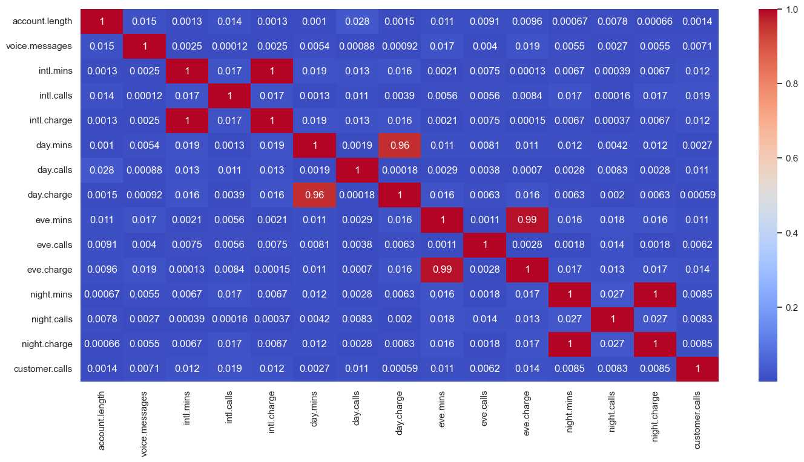
CORRELATION MATRIX
We see a strong correlation in some columns, Such as ‘Day Charge’ & ‘Day Minutes’ & these features will be removed during feature selection to avoid ‘Multi collinearity Issues’

Slide 18
RECOMMENDATIONS
Improve network coverage churned state
In international plan provide some discount plan to the customers
Improve voice mail quality or take feedback from the customer
Provide discount to those customer who spent more minutes.
Improve the service of call center & take frequently feedback from the customers regarding their issue & try to solve it as soon as possible.

Slide 19
CONCLUSION FOR EDA
These are some of the quick insights on churn analysis from above analysis :
The customers who used international plan services are higher in churners .
So basically the people who bought International plans are churning in big
number. Probably because of connectivity issues or high call charge.
In voicemail section when there are more than 20 voice mail messages there is churn so it basically means that the quality of voice mail is not good.
The customer who have high day call minutes also have high call price these
customer tends to churn.

Slide 20
Feature Engineering & Model Building Part
Today we will be covering the following points:-
Outlier Detection part
Feature Engineering.
Balancing of the data set.
Model Building using different models.

Slide 21
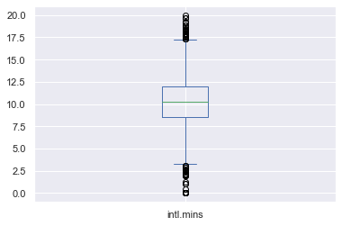
Outlier Detection Part
We have removed the outliers using IQR method
Ex:-
Detecting using Box plot first for intl. mins column.

Slide 22
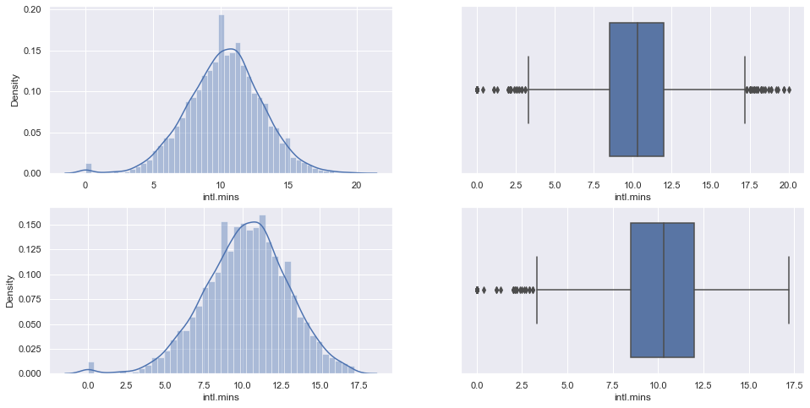
Outlier Detection Part
After applying IQR method the following were the results,
Trimming:-

Slide 23
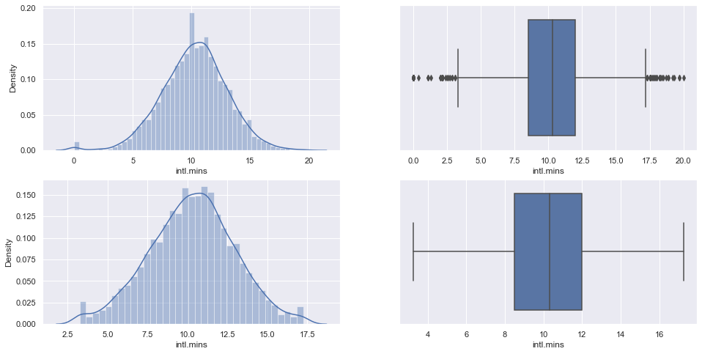
Outlier Detection Part
After applying IQR method the following were the results,
Capping:-

Slide 24
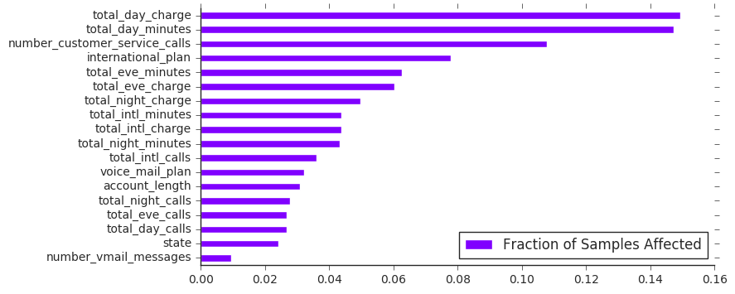
Feature Engineering.
Finding the feature which have highest predictive power.

Slide 25
Feature Engineering.
Finding the feature which have highest predictive power. We used random forest algorithm to find out the best features.
According to the feature importance analysis produced by the Random Forest algorithm, the following features had the highest predictive power:
total_day_minutes
total_day_charge
number_customer_service_calls
total_eve_minutes
international_plan
Splitting the data into train & test split :- We have split the data into train & test subsets.

Slide 26
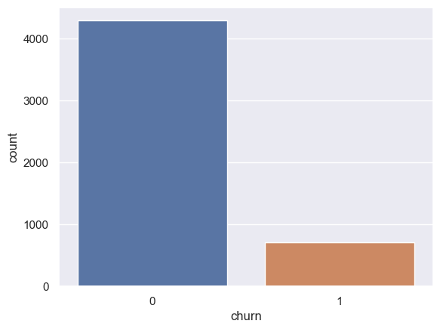
Feature Engineering.
We have used the following balancing techniques.
Over Sampling using smote.
Under Sampling.
Classic over Sampling technique
We came to know that,
Non churn customers – 4293
Churn customers – 707
The data is highly imbalanced.
The data is balanced using Random Over sample, using smoote
Hence,
Old data – (4293,22) , (707,1)
New data – (4293,22) , (4293,1)
Finding the data was balanced or no:-

Slide 27
Model Building Selecting the Best Model
Sr. No | Model | Accuracy (%) | Remarks
1 | Logistic Regression | 76
2 | Decision Trees | 82
3 | Random Forest | 99 | We choose RF as our final model
4 | Adaboost | 79
5 | Gaussian | 75

Slide 28
Model Deployment
After Model building & Evaluation process, we have deployed the code using “Stream lit”
We have selected the best model & used in our deployment phase.
DEPLOYMENT

Slide 29
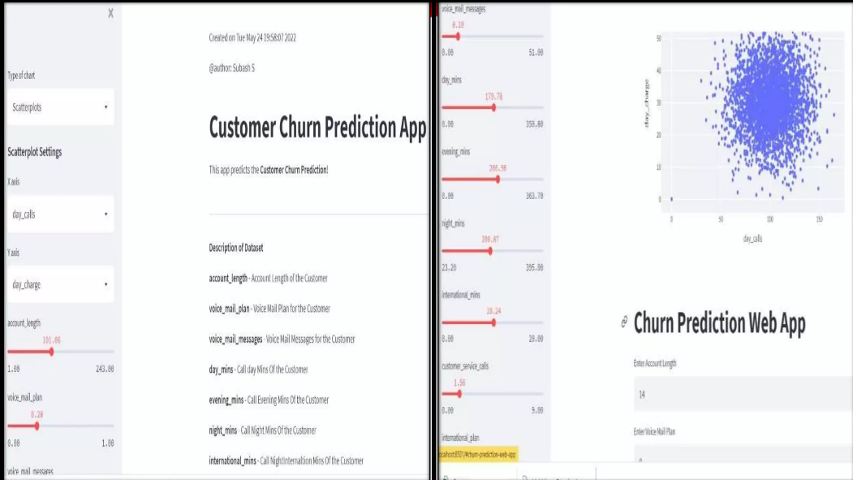

Slide 30
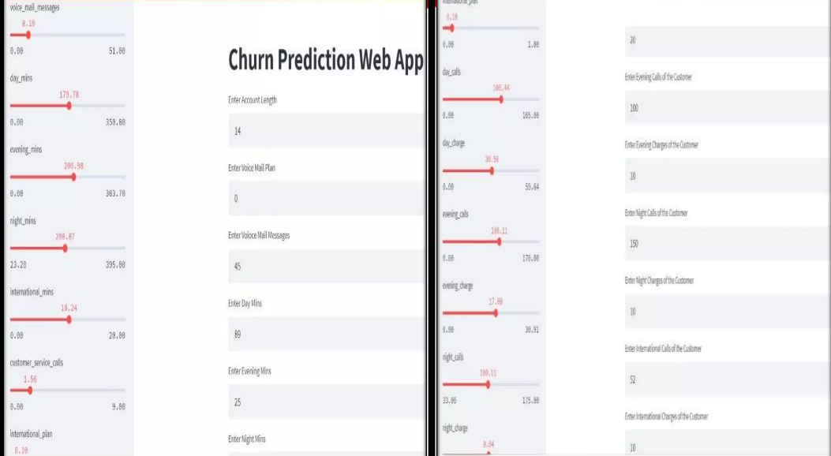

Slide 31
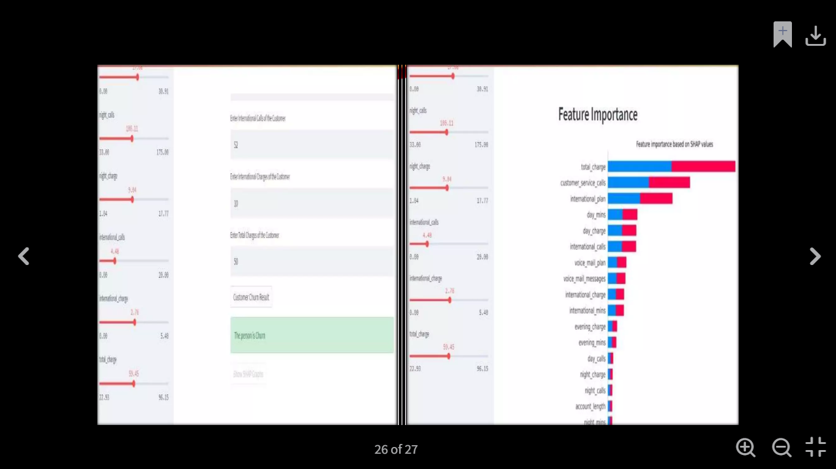
Output

